Slide 1

Model Calibration
Group 1

Slide 2




Contents
Method overview
Code for calibration
Pre-prepared full-scale results
Real-time small-scale results

Slide 3
Calibration Workflow Overview

Slide 4
Bayesian Calibration
Possibilities:
Rejection
Sequential
MCMC
Annealing
Notes:
Go through each calibration method and then say why we chose rejection

Slide 5
Rejection
Chosen because:
Simplicity
etc...
How it works:
Notes:
Go through why we chose this method

Slide 6
Priors
Parameter | Range | Prior distribution
Min Death Age | (10,40) | Uniform distribution
Max Death Age | (20,50) | Uniform distribution
Infertile fertile Age | (25,40) | Uniform distribution
Fission Probability | (0.05,0.2) | Uniform distribution
Harvest variance | (0.5,1.5) | Uniform distribution
Spatial variance | (0,0.5) | Uniform distribution

Slide 7
Likelihood Function

Slide 8
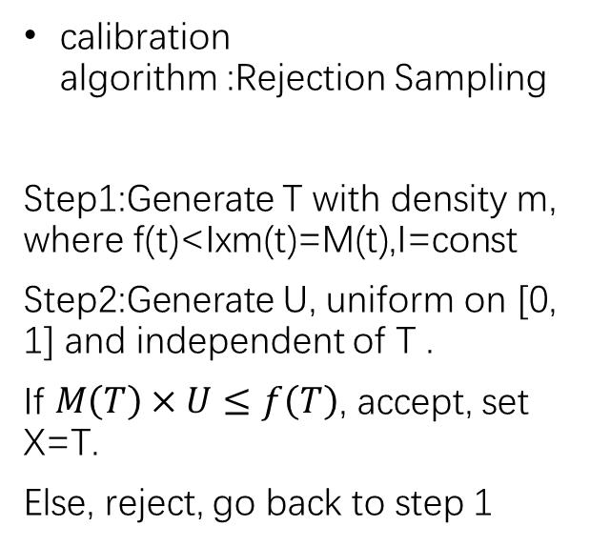
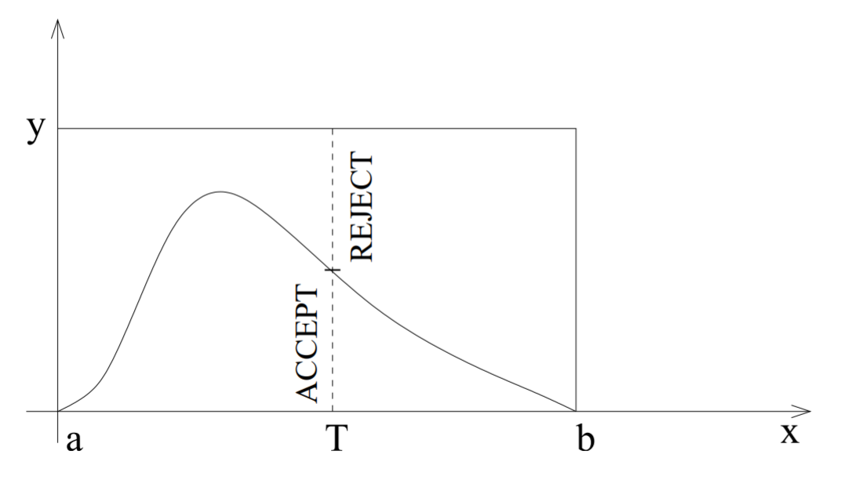
Calibration Algorithm

Slide 9
Termination Criterion

Slide 10
Code for calibration
(Implementation)
1
Write bash file so that our model can run in R
2
Programme to get model input and output
3
Write some code for easyABC
Notes:
Overview of implemented code

Slide 11
Code for Priors

Slide 12
Code for Likelihood Function

Slide 13
Code for Algorithm

Slide 14
Termination Criterion Code

Slide 15

Pre-prepared full-scale results

Slide 16
Real-time small-scale results

